Slide 1
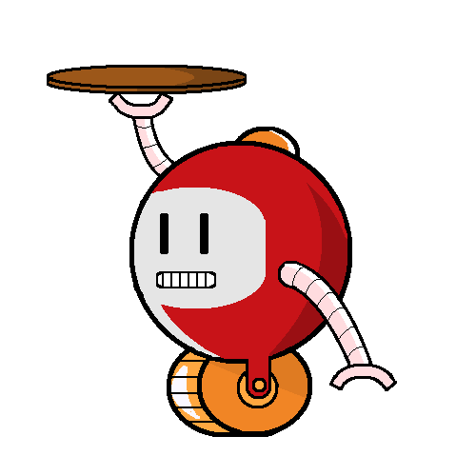
LazyBots
Sfwr eng 4G06A & Tron 4TB6a

Slide 2
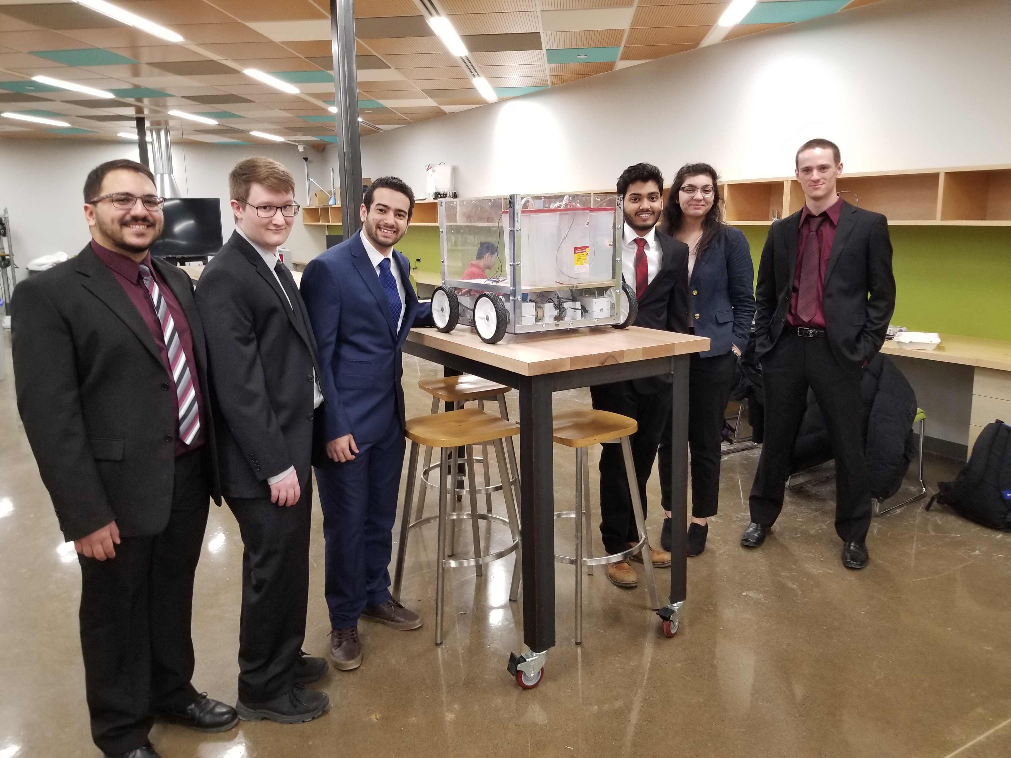
Meet the Team
Karim Guirguis
David Hemms
Marko Laban
Curtis Milo
Keyur Patel
Alexandra Rahman
Alfred

Slide 3
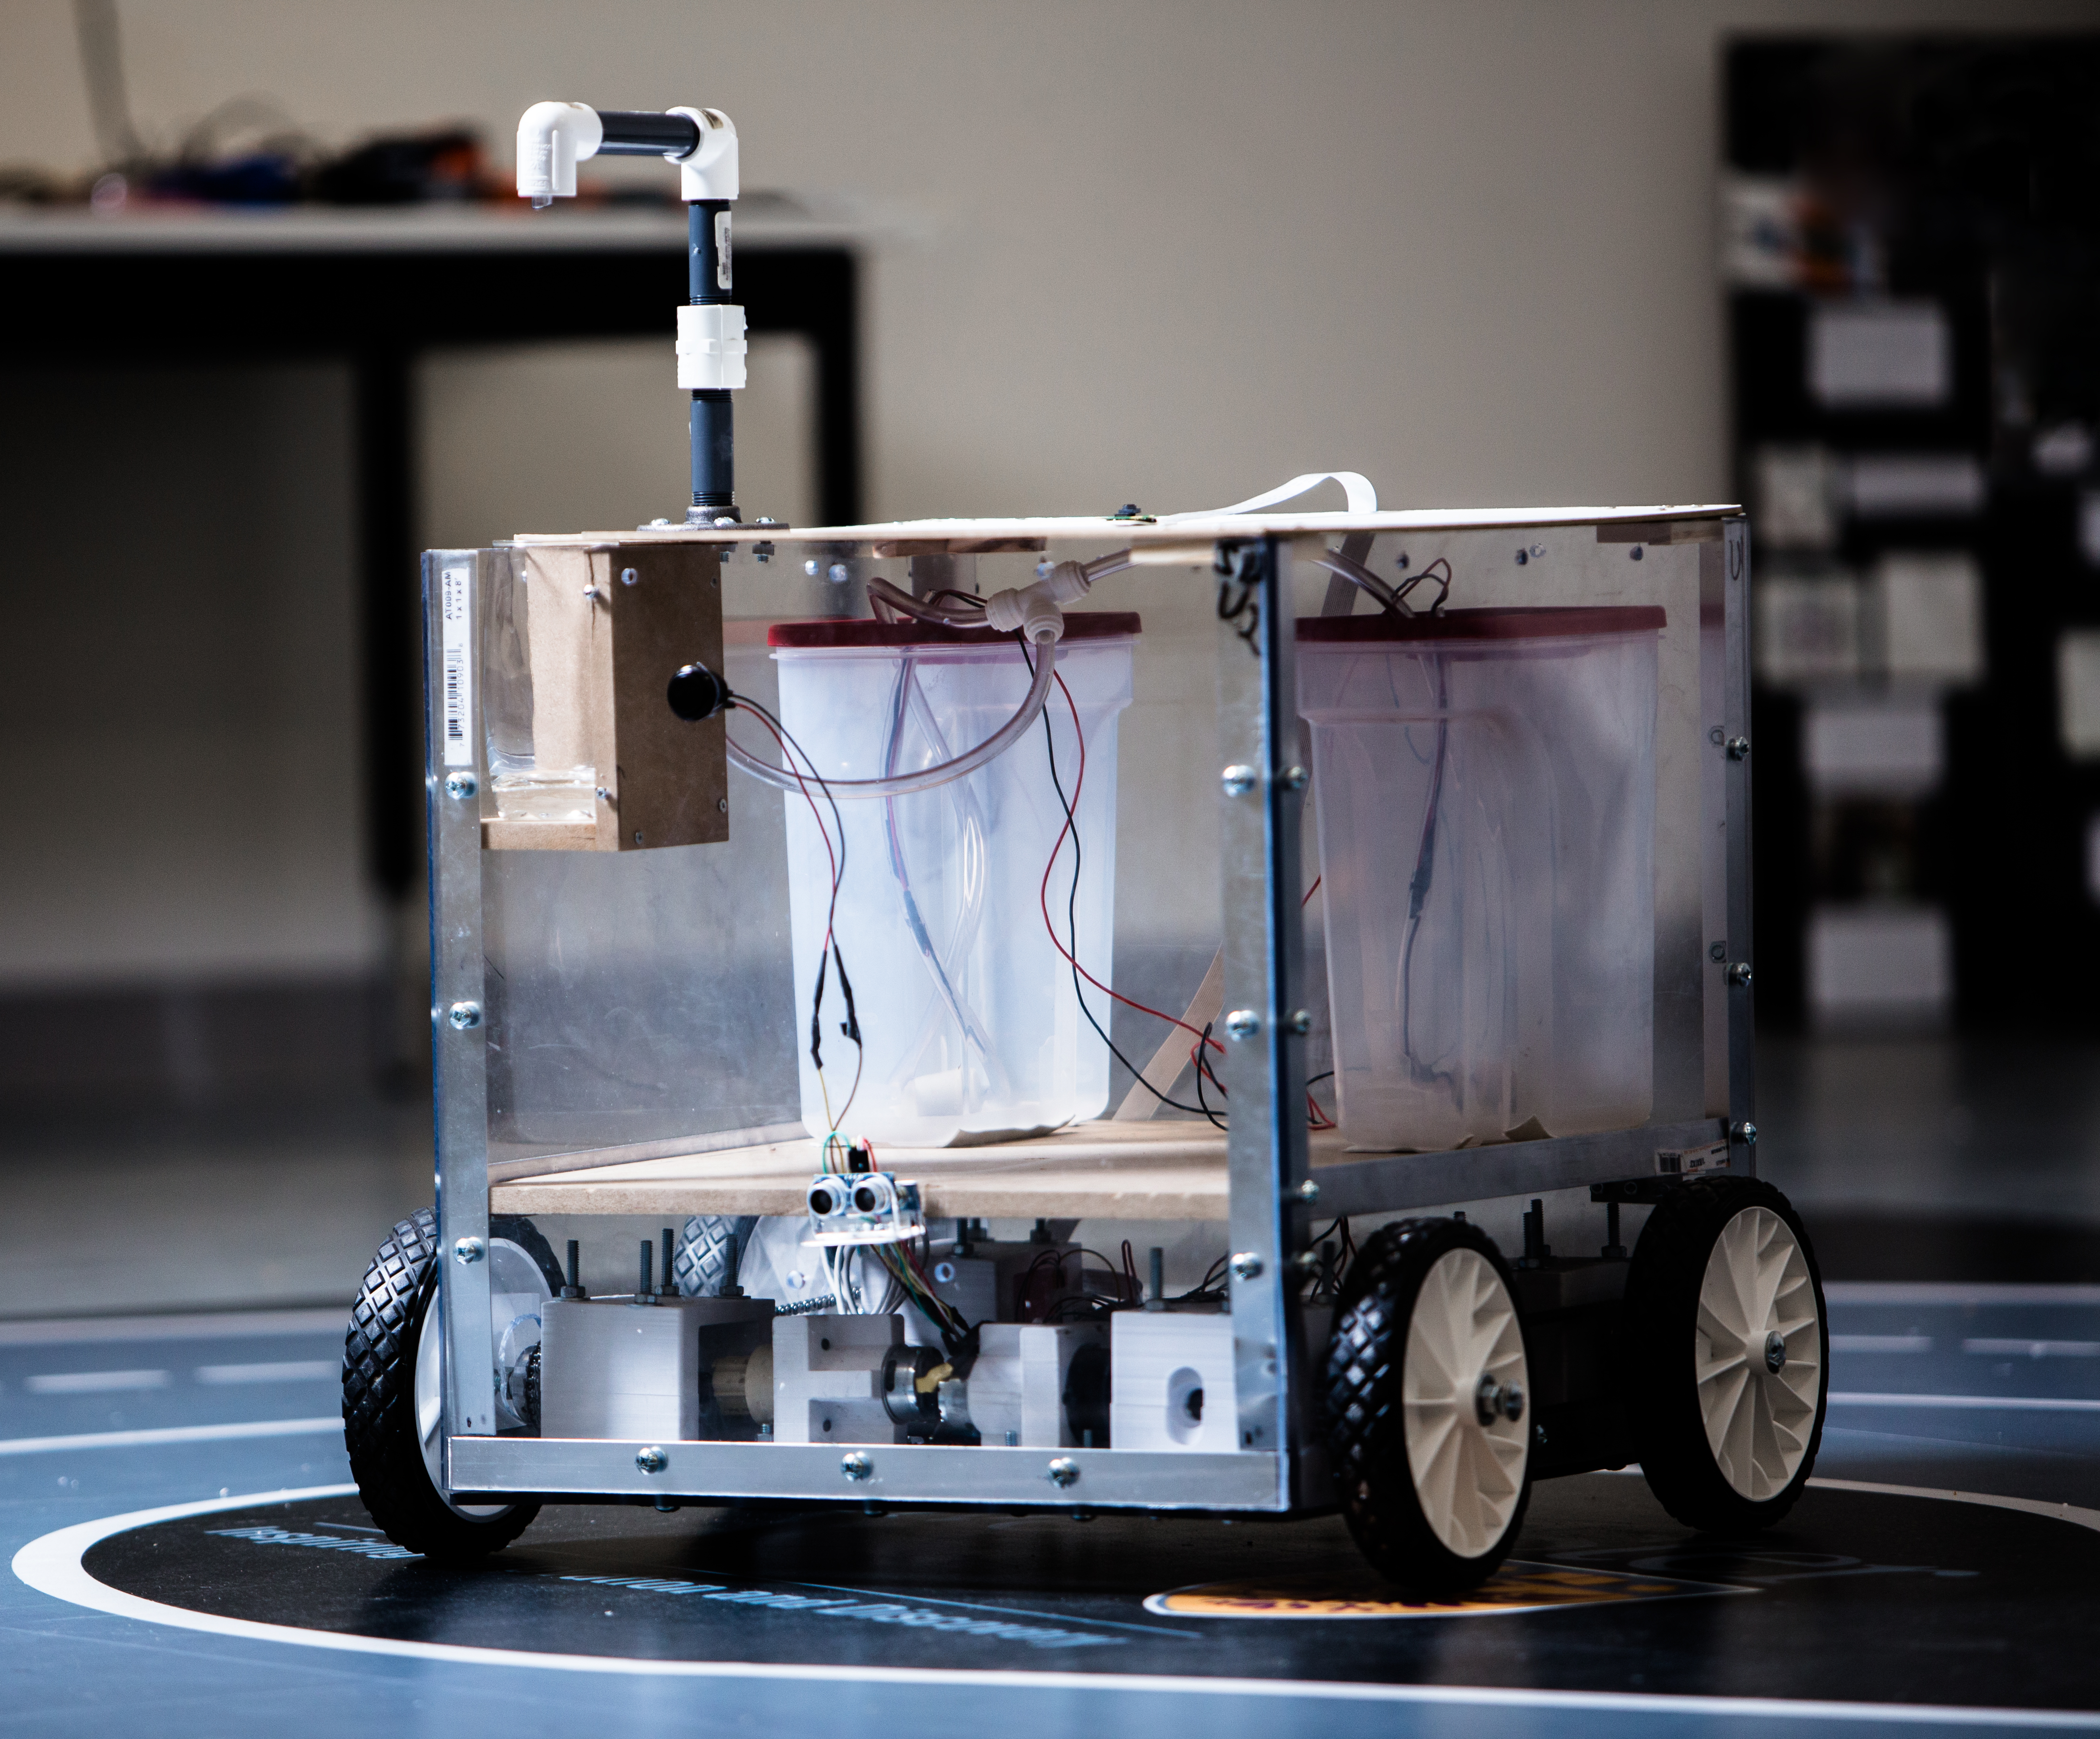
Meet Alfred
A self driving robot
A drink dispenser

Slide 4
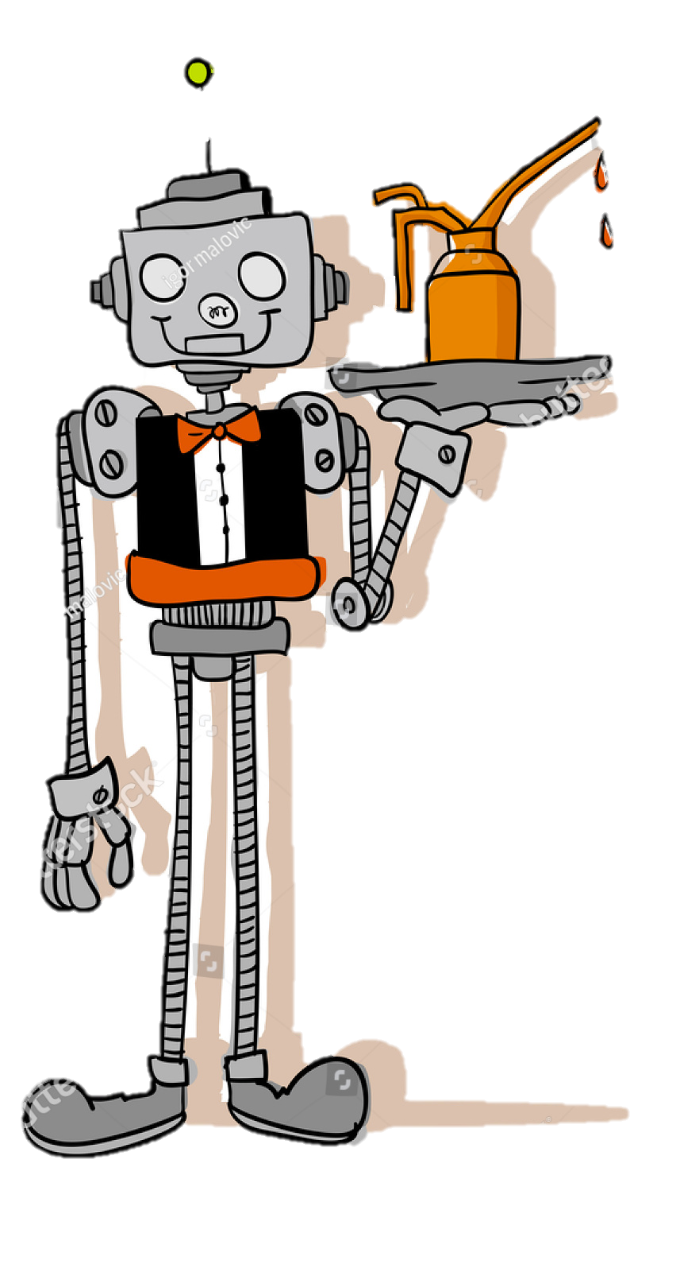
How Alfred Interacts in Social Settings
RESTAURANT CLIENT
Customer orders a drink
Arrives at table
Drink dispensed

Slide 5
How Alfred Interacts with Staff
RESTAURANT STAFF
Drink supply levels
Power supply levels
RESTAURANT MANAGEMENT
Restaurant layout
Available drinks
Reports
Call Home

Slide 6
Alfred in Action

Slide 7
The Magic Behind Alfred

Slide 8
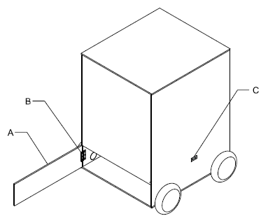
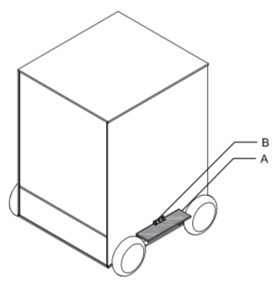
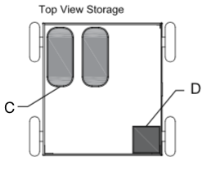
THE MECHANICAL DESIGN

Slide 9
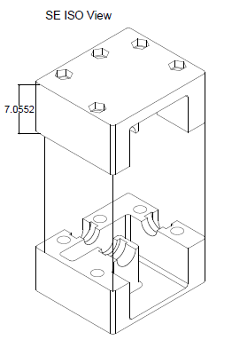
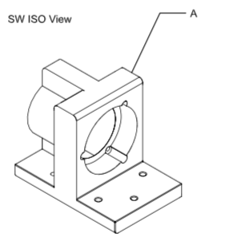
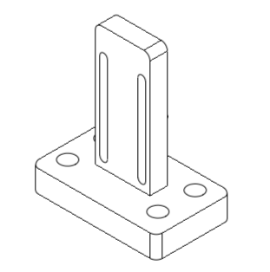
THE MECHANICAL DESIGN

Slide 10
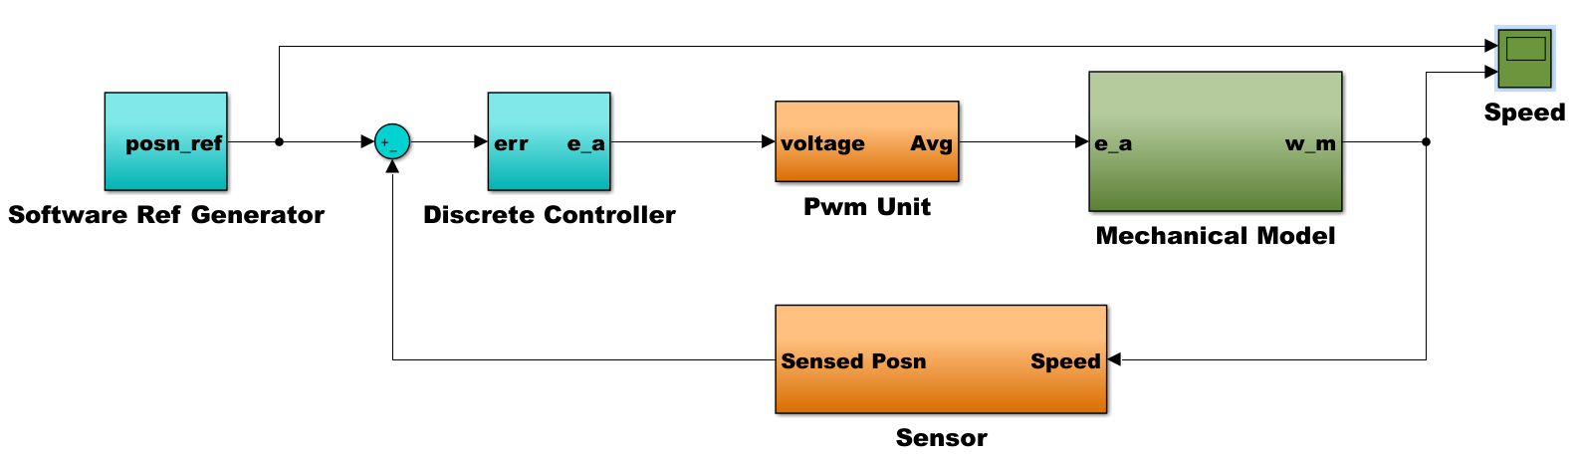
THE EMBEDDED DESIGN
Motor Control uses PWM to control voltage
Use of Ultra Sonic sensors
Image processing used to track relative location
Pumping System separated and isolated

Slide 11
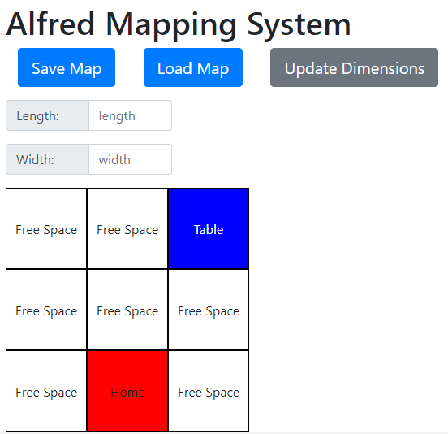
THE SOFTWARE DESIGN
CLIENT APPLICATION
User Interface
MANAGER SYSTEM
Restaurant Layout
Available Drinks

Slide 12
THE SOFTWARE DESIGN
ALFRED
Autonomous Navigation and Dispensing
SERVER
Communication Between All Sub-systems
Management of Queue

Slide 13
COST BREAKDOWN
Polycarbonate $150
Drill Motors and Batteries $100
H Bridge $34
Raspberry pi and Battery $62
Pi Camera $35
16GB Micro SD Card $10
Hardware $130
Sprockets and Ball Bearings $62
Chain and Chain Breakers $25
Encoders and Ultrasonic Sensors $35
Electrical Components $42
Total: $735

Slide 14
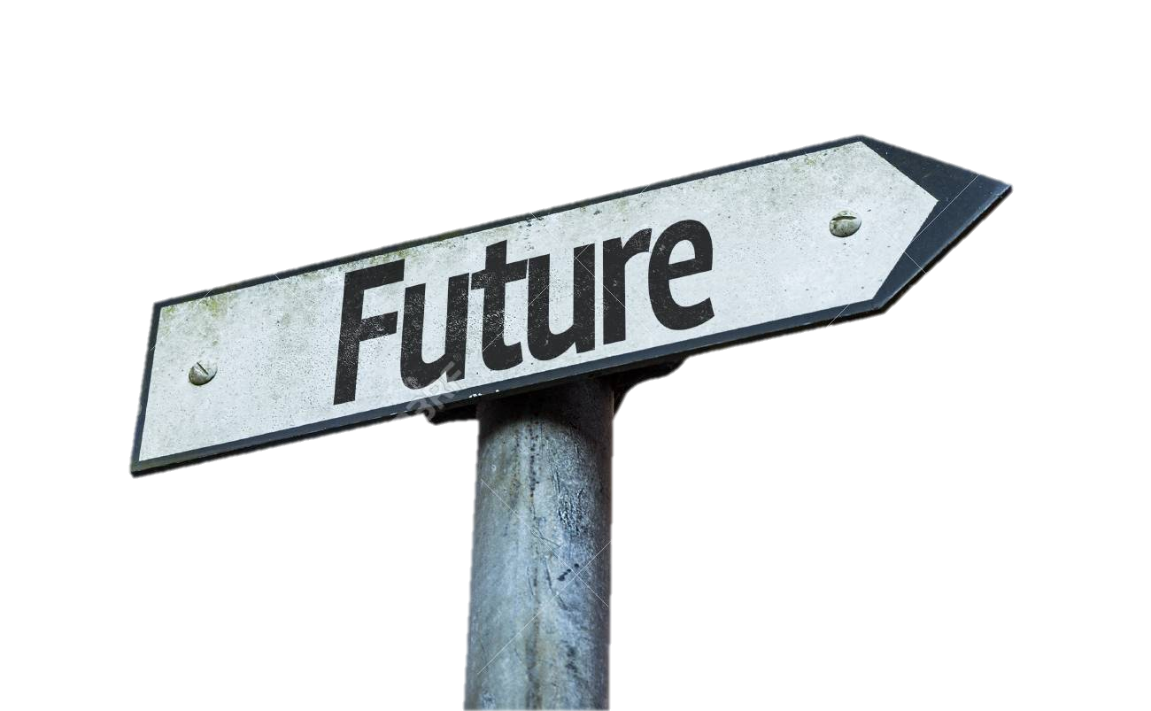
Future Enhancements
Point of Sale Systems
Dispensing System
Encrypt Communication
Robustness through Sensor Fusion
Navigational Robustness
Questions?

